Slide 1

peeko.
Unlocking the wisdom of crowds
Peek. Speak. Repeat.
Notes:
The black and white landscapes of an introvert, a shy speaker, a lost professional, and an idle mind need to be illuminated with the colors of hope, and the wisdom of crowds
Networking has become an inherent part of our lives. Humans thrive and learn through conversations. …and a conversation is much more significant than what a Tweet or Instagram post can capture. A conversation is about the emotion, the body language, and the relationships we form through meaningful interactions.
The pandemic has furthermore accentuated and has yet again reminded us the importance of physical connections.
It is all about hearing and sharing the stories and experiences and growing together IN THE REAL WORLD.
Let say, I have 2 hours of free time between my classes, I don’t know what to do. I would love to hear and learn from a peer, but I don’t know who is interested in what.
We introduce to you, PEEKO – a one-stop platform that leverages the power of technology to map your areas of interest, to find like-minded individuals in your neighborhood, and facilitate meaningful dialogues that add value.

Slide 2




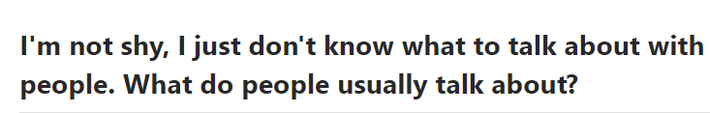
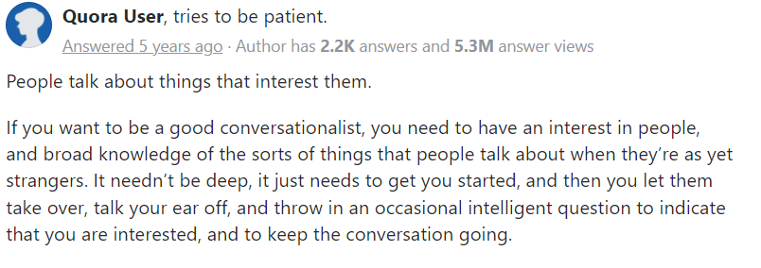


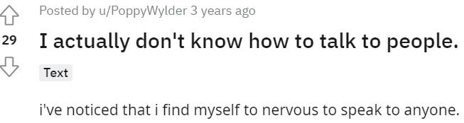
Problem
Pluralistic Ignorance Everyone is willing to talk but thinks everyone else is unwilling.
Psychological Experiment, The Cut
People don’t know who is interested in what or how to go about having a conversation
The Average American 5 hours spent each day doing nothing
The Millennial 26% do not know their neighbour's first name
CDC²
OnePoll Study⁴
The Chasing Loneliness 37% of meals consumed alone not by choice
Forbes⁶
Sources available in Appendix
Notes:
Our problem is more pronounced than what it seems.
The number of unproductive hours that we spend each day can drastically be improved and channelized into time we spend on learning from our peers. It is often underestimated how much we can learn from our peers and surroundings.
But is it really that easy?
A psychological experiment in America’s unhappiest city, NewYork, in 2014 by University of Chicago concluded that social connection is essential for happiness and New York will be a happier city if they stepped out of their invisible bubble.
Two groups of people were made to travel on a bus. Half of them were asked to talk to the person next to them, and the other half to remain in their usual solitude. A survey was then sent out and as reported by the people who talked on their journey, they not just had a better travel experience but some also reported that it was intellectually enriching.
They pondered upon why at the first place were people not talking then?
PLURALISTIC IGNORANCE.
Read slide. Vicious circle!!

Slide 3

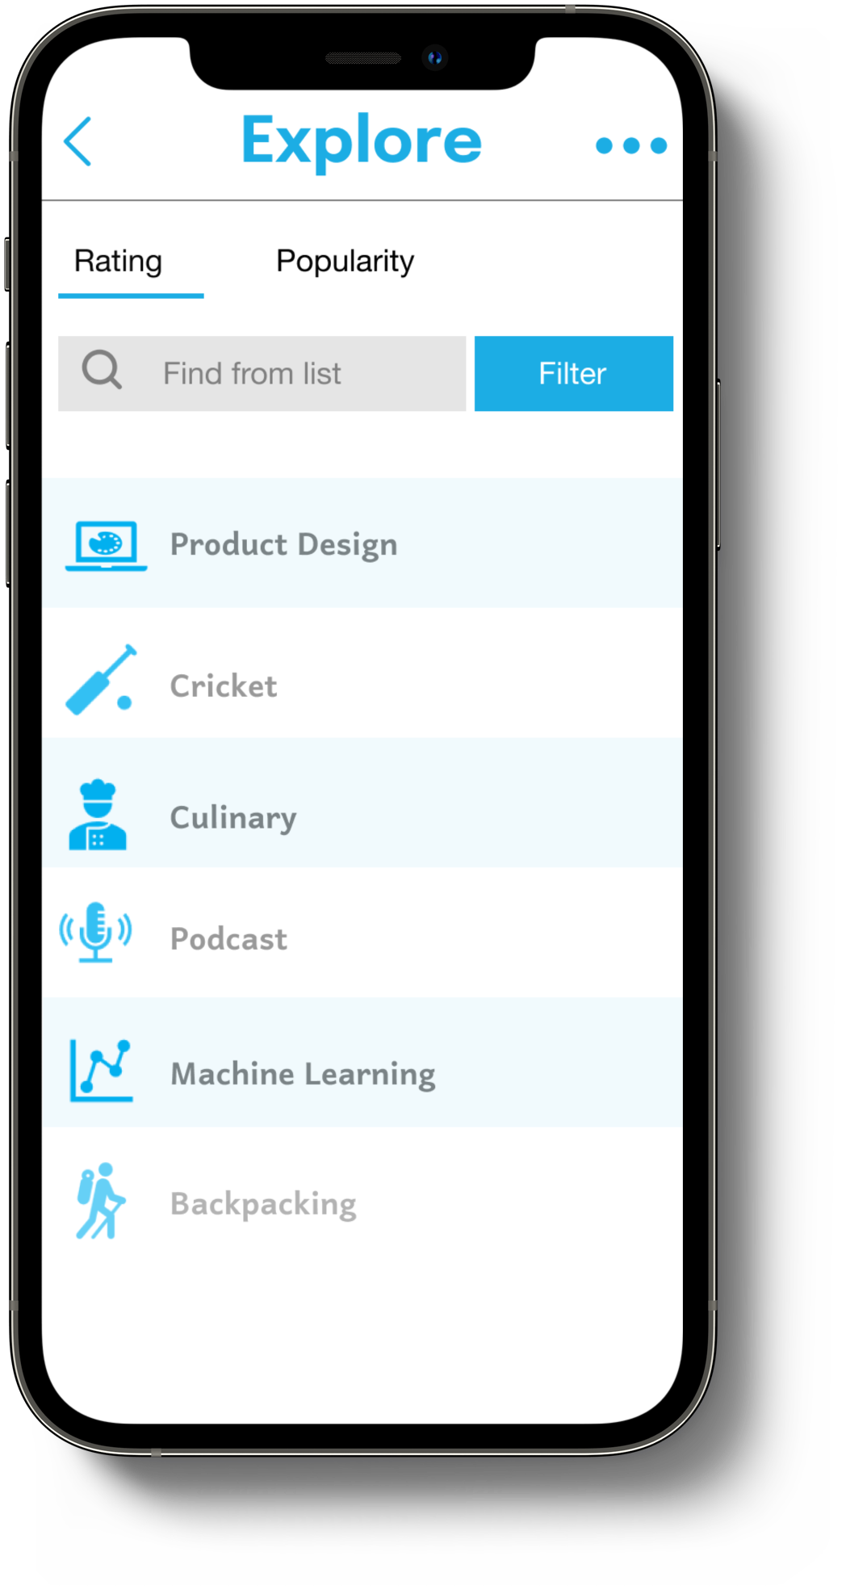
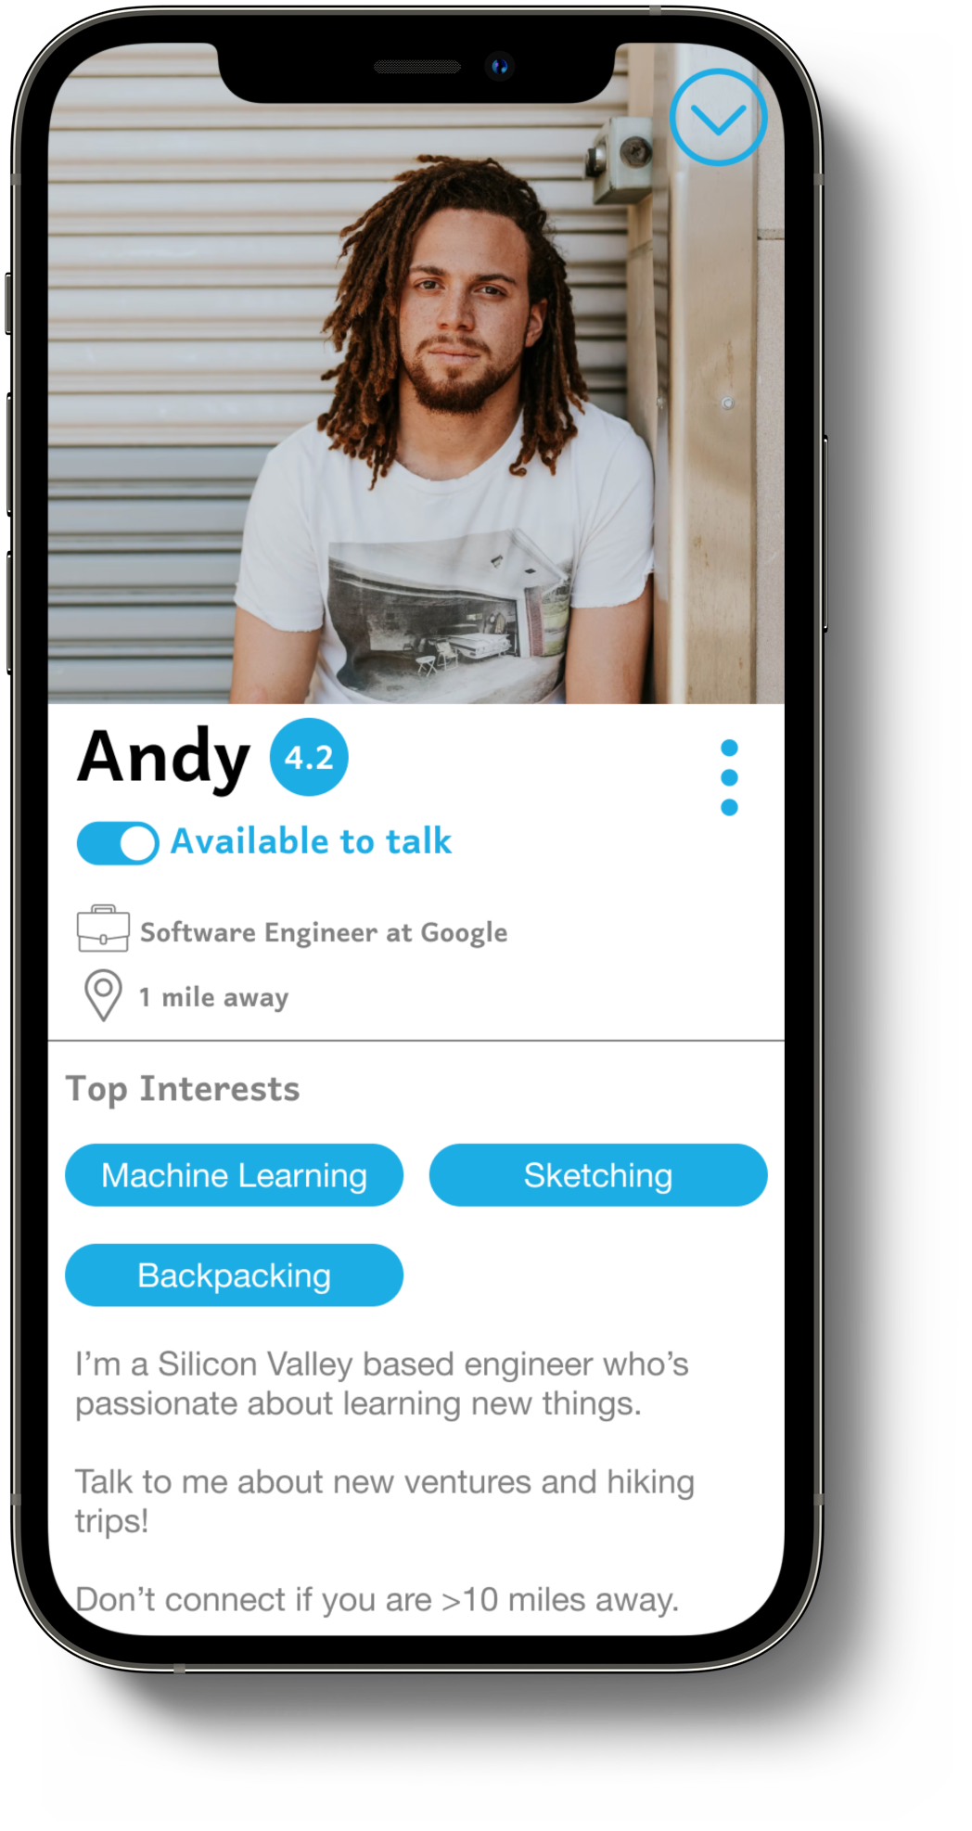
Mapping User Interests
Home
Explore an area of interest
Build your profile
Notes:
Sneak peek. MACHINE LEARNING INTEREST AREA
If Andy goes ahead and talks

Slide 4
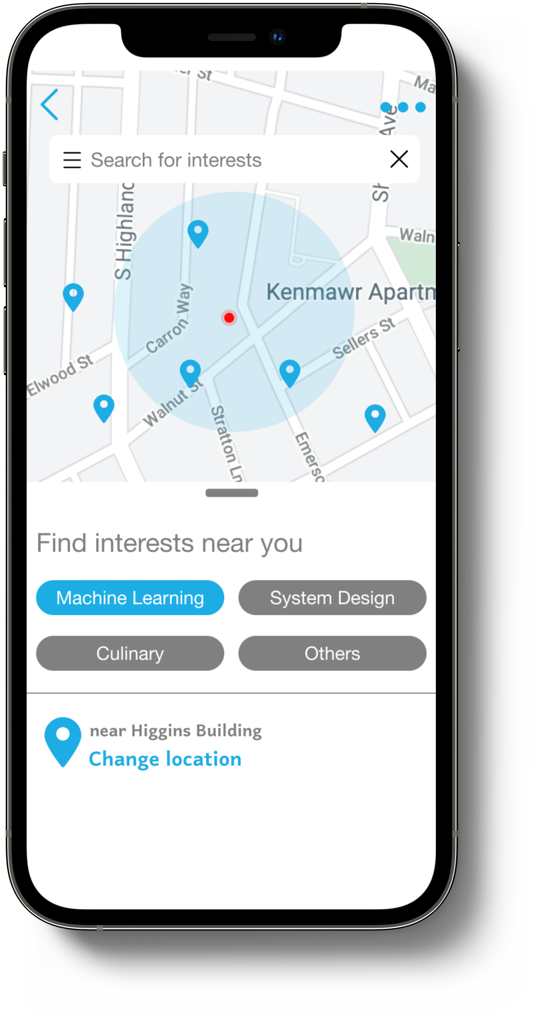
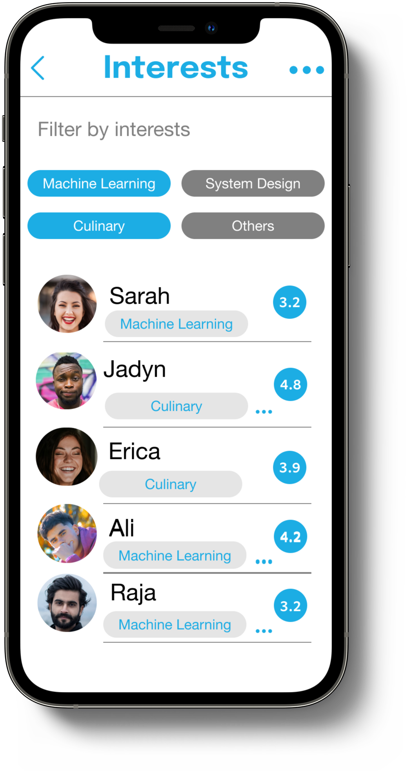
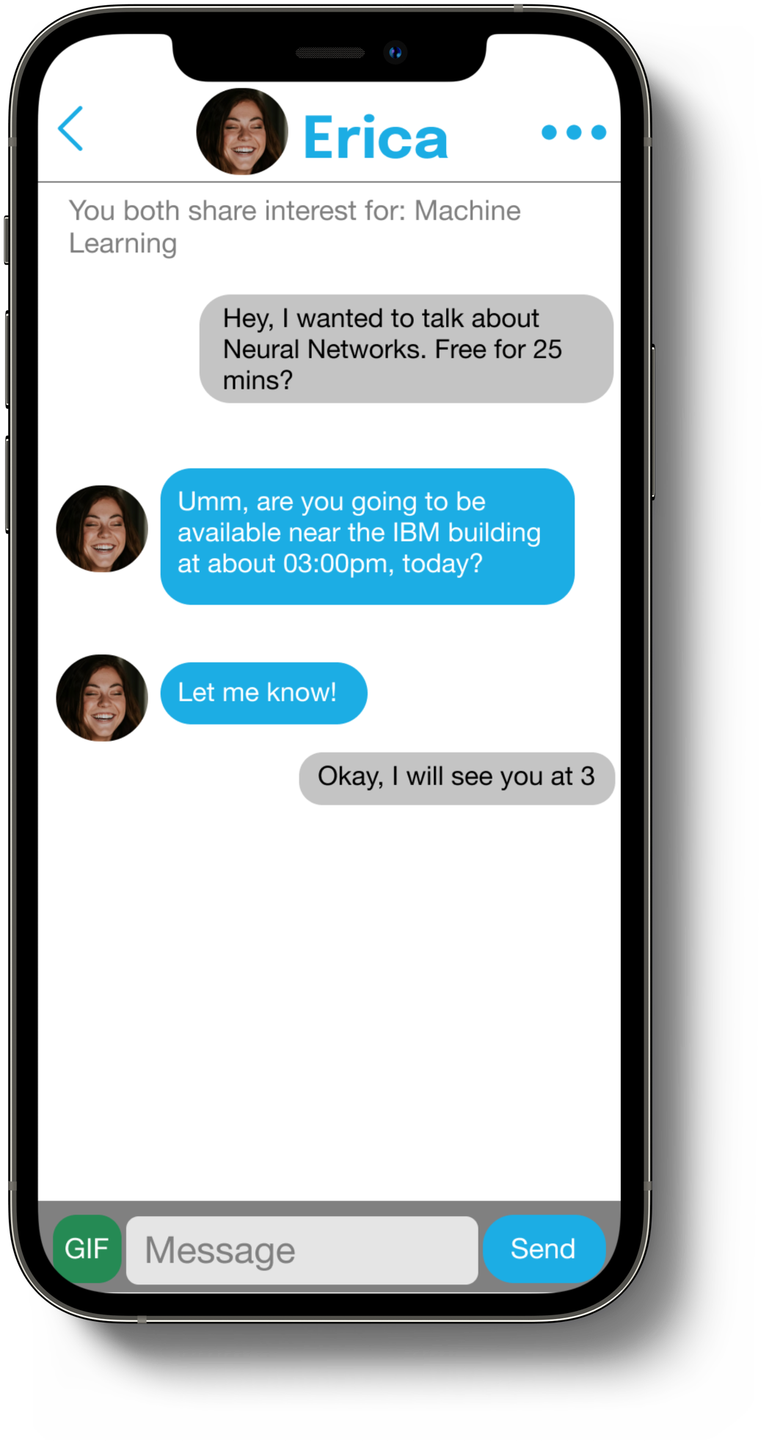
Make a nearby connection
Locate an interest match around you
Explore users with similar interest
Chat and schedule a meetup
Notes:
Let say Sarah, and then perhaps a week later Sarah talks Erica, then we slowly start to build a community. After each successful conversation, the users can endorse eachother much like LinkedIn, but not superficial since it is based on real conversations. Like Facebook, the community will start building. Andy will be able to see Erica as a mutual since he spoke to the middle node – Sarah, and the circle of machine learners in the area would start coming up

Slide 5

Join the mission
Building real-world knowledge communities by personalizing everyday conversations
Notes:
Our mission is to leverage these physical connections, and build communities of folks with similar interests. At Peeko, we envision to build

Slide 6
Why are conversations not happening?
Do you find it easy to begin conversations with everyone in-person?
Do you think physical interactions are replaceable?
Do you know the interest areas of potentially everyone you meet?
If your response is NO for any of the above questions, then you are the customer!
Sources available in Appendix

